Slide 1
Solar anomalous chemical composition and planet formation
Adriana Barbieri

Slide 2
Spectral synthesis
Main stellar parameters: surface gravity, effective temperature, metallicity, IMF.
Main spectral features: continuum, absorption/emission lines, break, curve of growth
From the equivalent width of the spectral absorption lines the chemical abundances of the stellar photospheric elements can be inferred.
Very-small intrinsic elemental abundance differences can be detected by comparing spectra of stars with the same atmospheric parameters.
The aim is to to find a signature in the stellar chemical composition due to the presence of planets.
The study of spectral relative abundances as an application to exoplanet detection

Slide 3
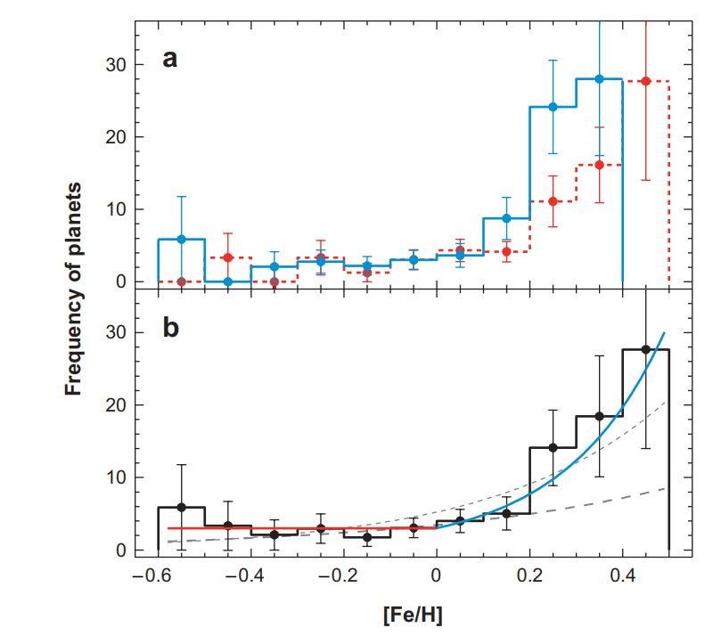
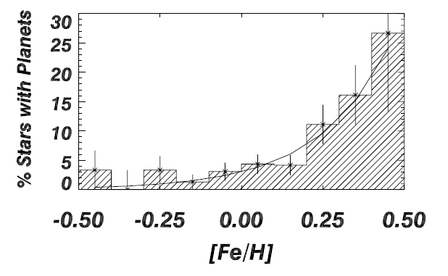
Planet–Metallicity correlation
Several independent spectroscopic analyses have determined a correlation between the metallicity of stars and the probability that the star hosts a planet.
Indeed stars hosting planets are systematically more metal-rich than average and the frequency of planetary systems increases with [Fe/H].
Fischer & Valenti, 2005
Udry & Santos, 2007

Slide 4
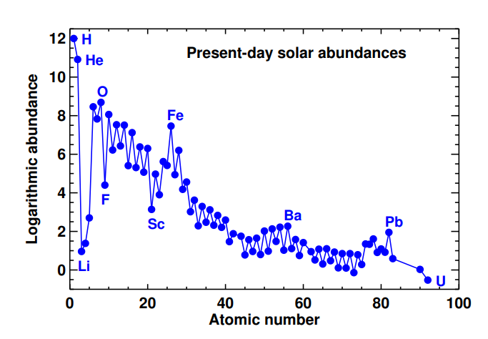
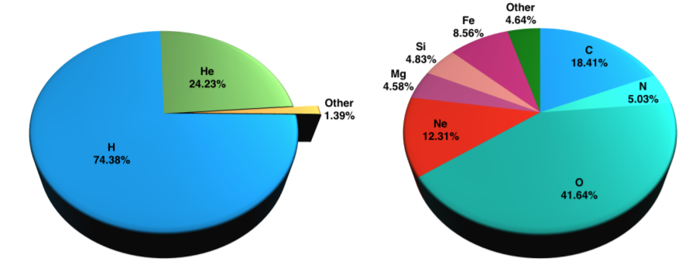
Solar photospheric abundances
Asplund et al, 2021

Slide 5
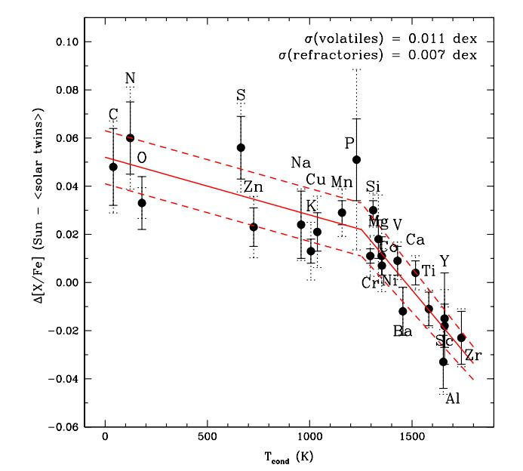
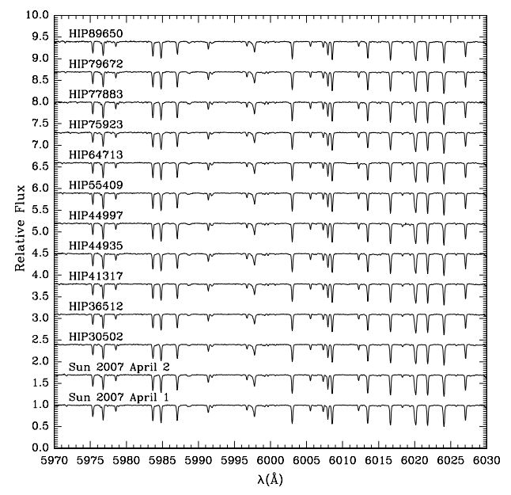
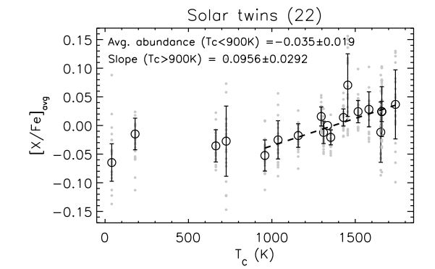
Relative abundances
Melendez et al. (2009) conducted a high resolution spectroscopic survey of the Sun, 11 solar twins and 10 solar analogs (with similar atmospheric properties) and derived accurate relative chemical abundances.
The spectral analysis highlighted a significant correlation between [X/Fe] and condensation temperature (Tc): volatile elements (Tc < 900 K) are more abundant in the Sun relative to the twins while elements that easily form dust (Tc > 900 K, refractories) are underabundant, with an offset between depletion and enhancement of 20%.
Ramírez et al, 2009
Meléndez et al, 2009

Slide 6
Solar composition and planet formation
If the Sun and its twins formed from gas clouds with very similar initial chemical composition, where are the missing refractory elements in the solar case?
Melendez et al (2019) suggested that the Solar anomalous chemical composition may be due to dust condensation during the formation of planets.
Indeed inner solar system objects are enriched in refractory elements relative to volatiles (radial iron gradient pointing towards smaller heliocentric distances); the observed offset in the chemical abundance of the Sun would roughly disappear if the total mass of refractory elements in the terrestrial planets of the solar system today were to be added to the solar convective zone.
Since the majority of solar twins did not form planets, their original chemical compositions should not have been altered, with no deficiency of refractories and the original abundance of volatiles retained, as observed.
Thus the formation of the terrestrial planets might have given the Sun its peculiar surface composition; a similar abundance pattern that were to be detected in the photosphere of other stars may then hint at the presence of planetary systems.

Slide 7
Other scenarios
Galactic-evolution effects
Supernova pollution
Early dust separation
Dust separation during the formation of terrestrial planets
The role of giant planets:
The presence of iron and heavy metals in the core of giant planets would mean that their host stars are expected to show an abundance pattern similar to the solar one.

Slide 8
References
Ramírez et al, A&A 508, L17-L20, 2009
Meléndez et al., ApJ, 704:L66–L70, 2009
Asplund et al, Ann.Rev.Astron.Astrophys.47:481-522, 2009
Asplund et al, arXiv:2105.01661 [astro-ph.SR], 2021
Gonzalez, MNRAS 285.2:403-412, 1997
Udry & Santos, Annu. Rev. Astron. Astrophys. 45:397-439, 2007
Fischer & Valenti, ApJ, 622:1102–1117, 2005

